Slide 1
Indeterminacy and creation in cultural comparison
Yukio Irie
Osaka University

Slide 2
Contents:
1 What is the culture in globalizing society
2 Indeterminacy in cultural comparison

Slide 3
1 What is the culture in globalizing society
Collingwood’s thesis
“Every statement that any body ever makes is made in answer to a question”
(Collingwood, An Essay on Metaphysics, Oxford, 1939, p. 23)

Slide 4
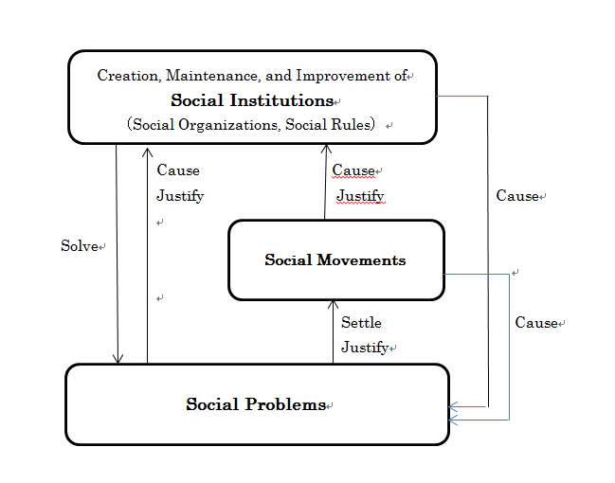
1 What is the culture in globalizing society

Slide 5
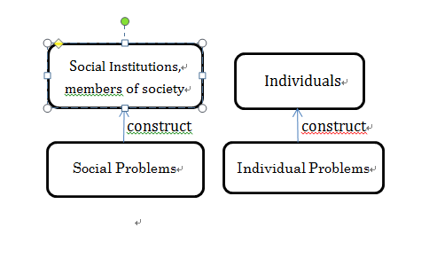
1 What is the culture in globalizing society

Slide 6
1 What is the culture in globalizing society
Culture in the broad sense
“that complex whole which includes knowledge, belief, art, morals, law, custom, and any other capabilities and habits acquired by man as a member of society”
(Edward Burnett Tylor, 1832–1917).
This includes all questions and answers, or problems and solutions, in a society.

Slide 7
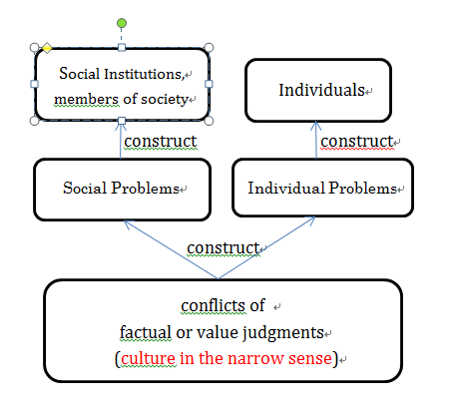
1 What is the culture in globalizing society

Slide 8
1 What is the culture in globalizing society
The culture as presuppositions of social problems are prior to or beyond social institutions.
The culture in a globalizing society are already multicultural and transcultural. Social problems here are often caused by cultural conflicts, which make such social problems difficult to solve.
And this difficulty comes from indeterminacy in cultural comparison.

Slide 9
2 Indeterminacy in cultural comparison
Indeterminacy in cultural comparison
(1) Indeterminacy between difference of concepts and difference of objects
‘This is eatable’.
‘This is uneatable’.
Here are two possible cases;
The difference ← different understanding of
the concept ‘eatable’.
← different cognition of the object.

Slide 10
2 Inditerminacy in cultural comparison
Can you divide
a definition of the concept ‘apple’ and
a definition of the object <apple> ?
We cannot.
(Cf. John L. Austin, Willard v-O. Quine, Donald Davidson)

Slide 11
2 Inditerminacy in cultural comparison
（2）Indeterminacy between conflict in setting a question and conflict in answers to a question.
“Which is eatable?” “X is eatable”
“X is not eatable, Y is eatable”.
If two persons understand ‘eatable’ differently,
they understand the question ‘Which is eatable?’ differently.
The difference
←different understanding of the question
←different cognition of the X

Slide 12
2 Indeterminacy in cultural comparison
From (1)indeterminacy (between concept and object)
To compare two cultures A and B is to confirm the common part and the specific differences of A and B.
But we can not confirm the common part and specific differences of A and B.
This makes us difficult to compare two cultures.
From (2) indeterminacy (between problem and answer)
Cultural conflicts are divided into two cases.
a conflict in setting a question
a conflict in answering to a question
But we cannot distinguish these two conflicts.
This makes us difficult to understand cultural conflicts.

Slide 13
Conclusion: Indeterminacy and creation
・The indeterminacy does not mean the impossibility of cultural comparison, but it just shows many possibilities of cultural comparison and understanding of cultural conflict.
・The indeterminacy means that we cannot decide theoretically how we make cultural comparison and how we understand the cultural conflicts.
・Therefore the indeterminacy gives us the space for creation of new cultural judgments and new social institutions.

Slide 14
Vielen Dank!

